Slide 1
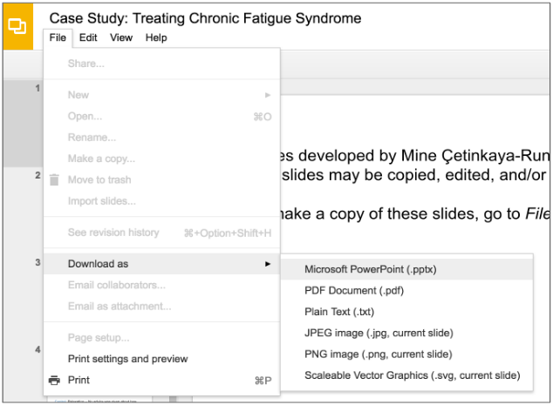
Slides developed by Mine Çetinkaya-Rundel of OpenIntro.
Translated from LaTeX to Google Slides by Curry Hilton of OpenIntro.
The slides may be copied, edited, and/or shared via the CC BY-SA license.
To make a copy of these slides, go to File > Download as > [option], as shown below. Or if you are logged into a Google account, you can choose Make a copy... to create your own version in Google Drive.

Slide 2
Experiments

Slide 3
Principles of experimental design
Control: Compare treatment of interest to a control group.
Randomize: Randomly assign subjects to treatments, and randomly sample from the population whenever possible.
Replicate: Within a study, replicate by collecting a sufficiently large sample. Or replicate the entire study.
Block: If there are variables that are known or suspected to affect the response variable, first group subjects into blocks based on these variables, and then randomize cases within each block to treatment groups.

Slide 4
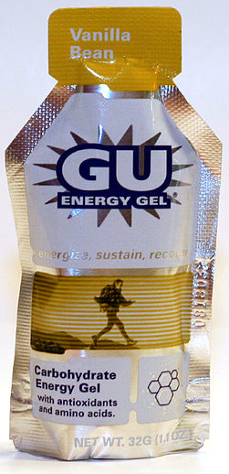
More on Blocking
We would like to design an experiment to investigate if energy gels makes you run faster:

Slide 5
More on Blocking
We would like to design an experiment to investigate if energy gels makes you run faster:
Treatment: energy gel
Control: no energy gel

Slide 6
More on Blocking
We would like to design an experiment to investigate if energy gels makes you run faster:
Treatment: energy gel
Control: no energy gel
It is suspected that energy gels might affect pro and amateur athletes differently, therefore we block for pro status:

Slide 7
More on Blocking
We would like to design an experiment to investigate if energy gels makes you run faster:
Treatment: energy gel
Control: no energy gel
It is suspected that energy gels might affect pro and amateur athletes differently, therefore we block for pro status:
Divide the sample to pro and amateur
Randomly assign pro athletes to treatment and control groups
Randomly assign amateur athletes to treatment and control groups
Pro/amateur status is equally represented in the resulting treatment and control groups

Slide 8
More on Blocking
We would like to design an experiment to investigate if energy gels makes you run faster:
Treatment: energy gel
Control: no energy gel
It is suspected that energy gels might affect pro and amateur athletes differently, therefore we block for pro status:
Divide the sample to pro and amateur
Randomly assign pro athletes to treatment and control groups
Randomly assign amateur athletes to treatment and control groups
Pro/amateur status is equally represented in the resulting treatment and control groups
Why is this important? Can you think of other variables to block for?

Slide 9
Practice
A study is designed to test the effect of light level and noise level on exam performance of students. The researcher also believes that light and noise levels might have different effects on males and females, so wants to make sure both genders are equally represented in each group. Which of the below is correct?
There are 3 explanatory variables (light, noise, gender) and 1 response variable (exam performance)
There are 2 explanatory variables (light and noise), 1 blocking variable (gender), and 1 response variable (exam performance)
There is 1 explanatory variable (gender) and 3 response variables (light, noise, exam performance)
There are 2 blocking variables (light and noise), 1 explanatory variable (gender), and 1 response variable (exam performance)

Slide 10
Practice
A study is designed to test the effect of light level and noise level on exam performance of students. The researcher also believes that light and noise levels might have different effects on males and females, so wants to make sure both genders are equally represented in each group. Which of the below is correct?
There are 3 explanatory variables (light, noise, gender) and 1 response variable (exam performance)
There are 2 explanatory variables (light and noise), 1 blocking variable (gender), and 1 response variable (exam performance)
There is 1 explanatory variable (gender) and 3 response variables (light, noise, exam performance)
There are 2 blocking variables (light and noise), 1 explanatory variable (gender), and 1 response variable (exam performance)

Slide 11
Difference Between Blocking and Explanatory Variables
Factors are conditions we can impose on the experimental units.
Blocking variables are characteristics that the experimental units come with, that we would like to control for.
Blocking is like stratifying, except used in experimental settings when randomly assigning, as opposed to when sampling.

Slide 12
More Experimental Design Terminology...
Placebo: fake treatment, often used as the control group for medical studies
Placebo effect: experimental units showing improvement simply because they believe they are receiving a special treatment
Blinding: when experimental units do not know whether they are in the control or treatment group
Double-blind: when both the experimental units and the researchers who interact with the patients do not know who is in the control and who is in the treatment group

Slide 13
Practice
What is the main difference between observational studies and experiments?
Experiments take place in a lab while observational studies do not need to.
In an observational study we only look at what happened in the past.
Most experiments use random assignment while observational studies do not.
Observational studies are completely useless since no causal inference can be made based on their findings.

Slide 14
Practice
What is the main difference between observational studies and experiments?
Experiments take place in a lab while observational studies do not need to.
In an observational study we only look at what happened in the past.
Most experiments use random assignment while observational studies do not.
Observational studies are completely useless since no causal inference can be made based on their findings.

Slide 15
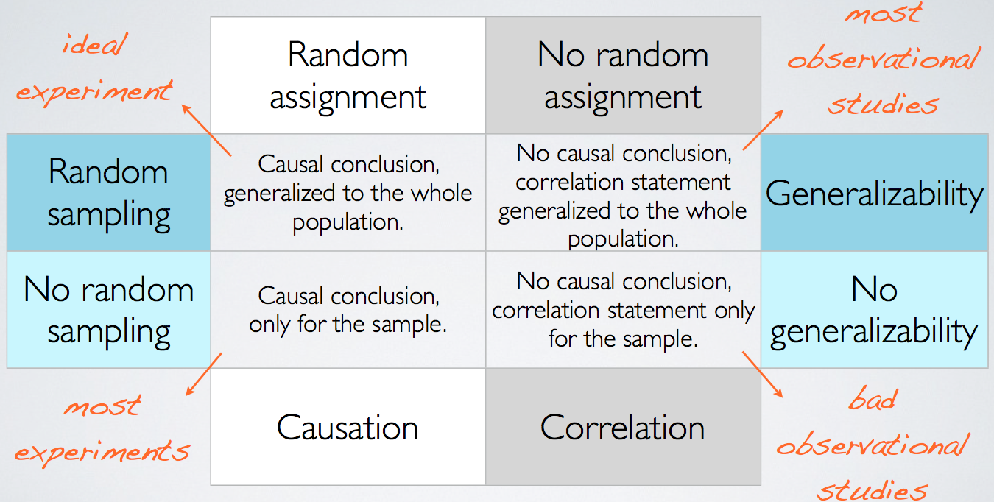
Random Assignment
vs. Random Sampling

Slide 16
Find more resources at openintro.org/os, including
Slides
Videos
Statistical Software Labs
Discussion Forums (free support for students and teachers)
Learning Objectives
Teachers only content is also available for Verified Teachers, including
Exercise solutions
Sample exams
Ability to request a free desk copy for a course
Statistics Teachers email group
Questions? Contact us.

